Slide 2
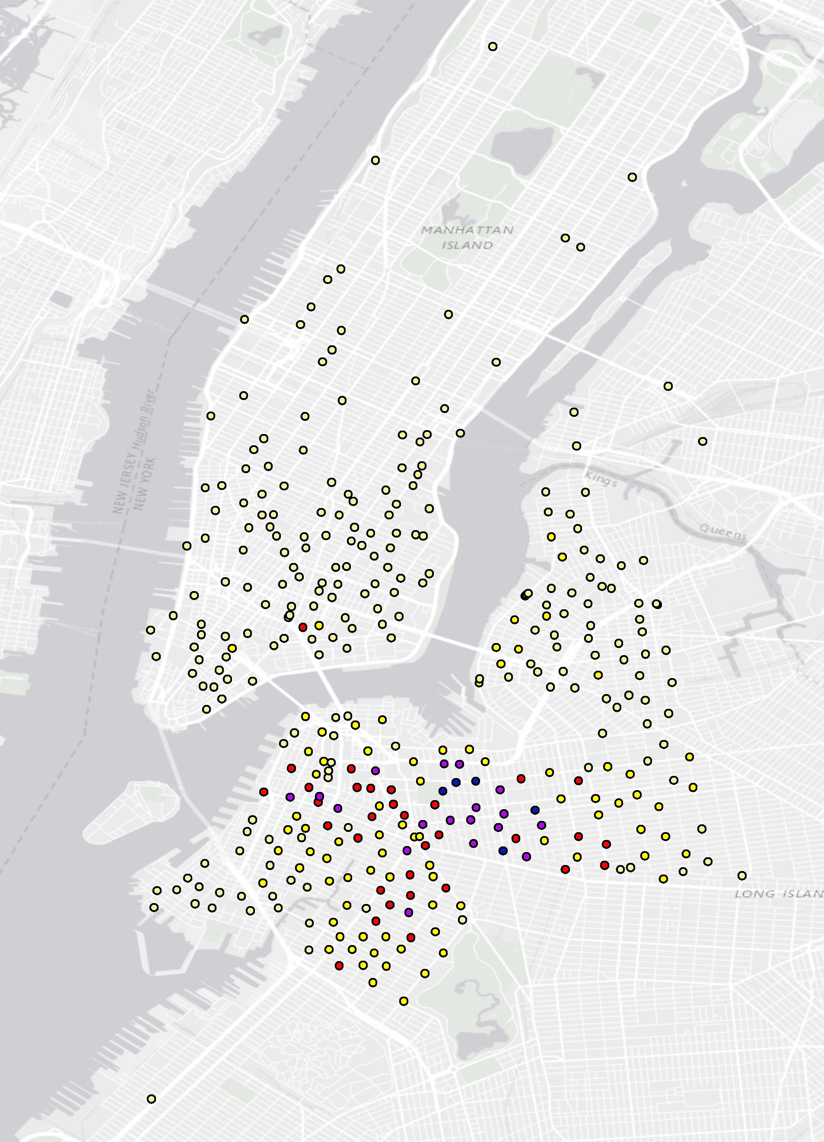
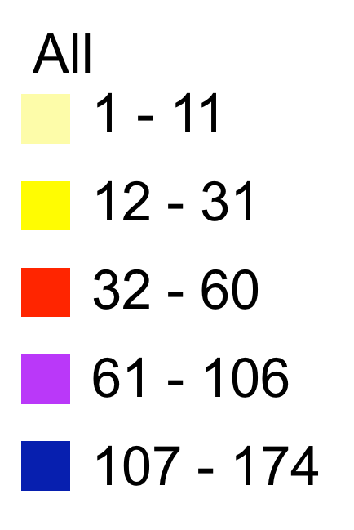
All
1 - 11
12 - 31
32 - 60
61 - 106
107 - 174

Slide 3
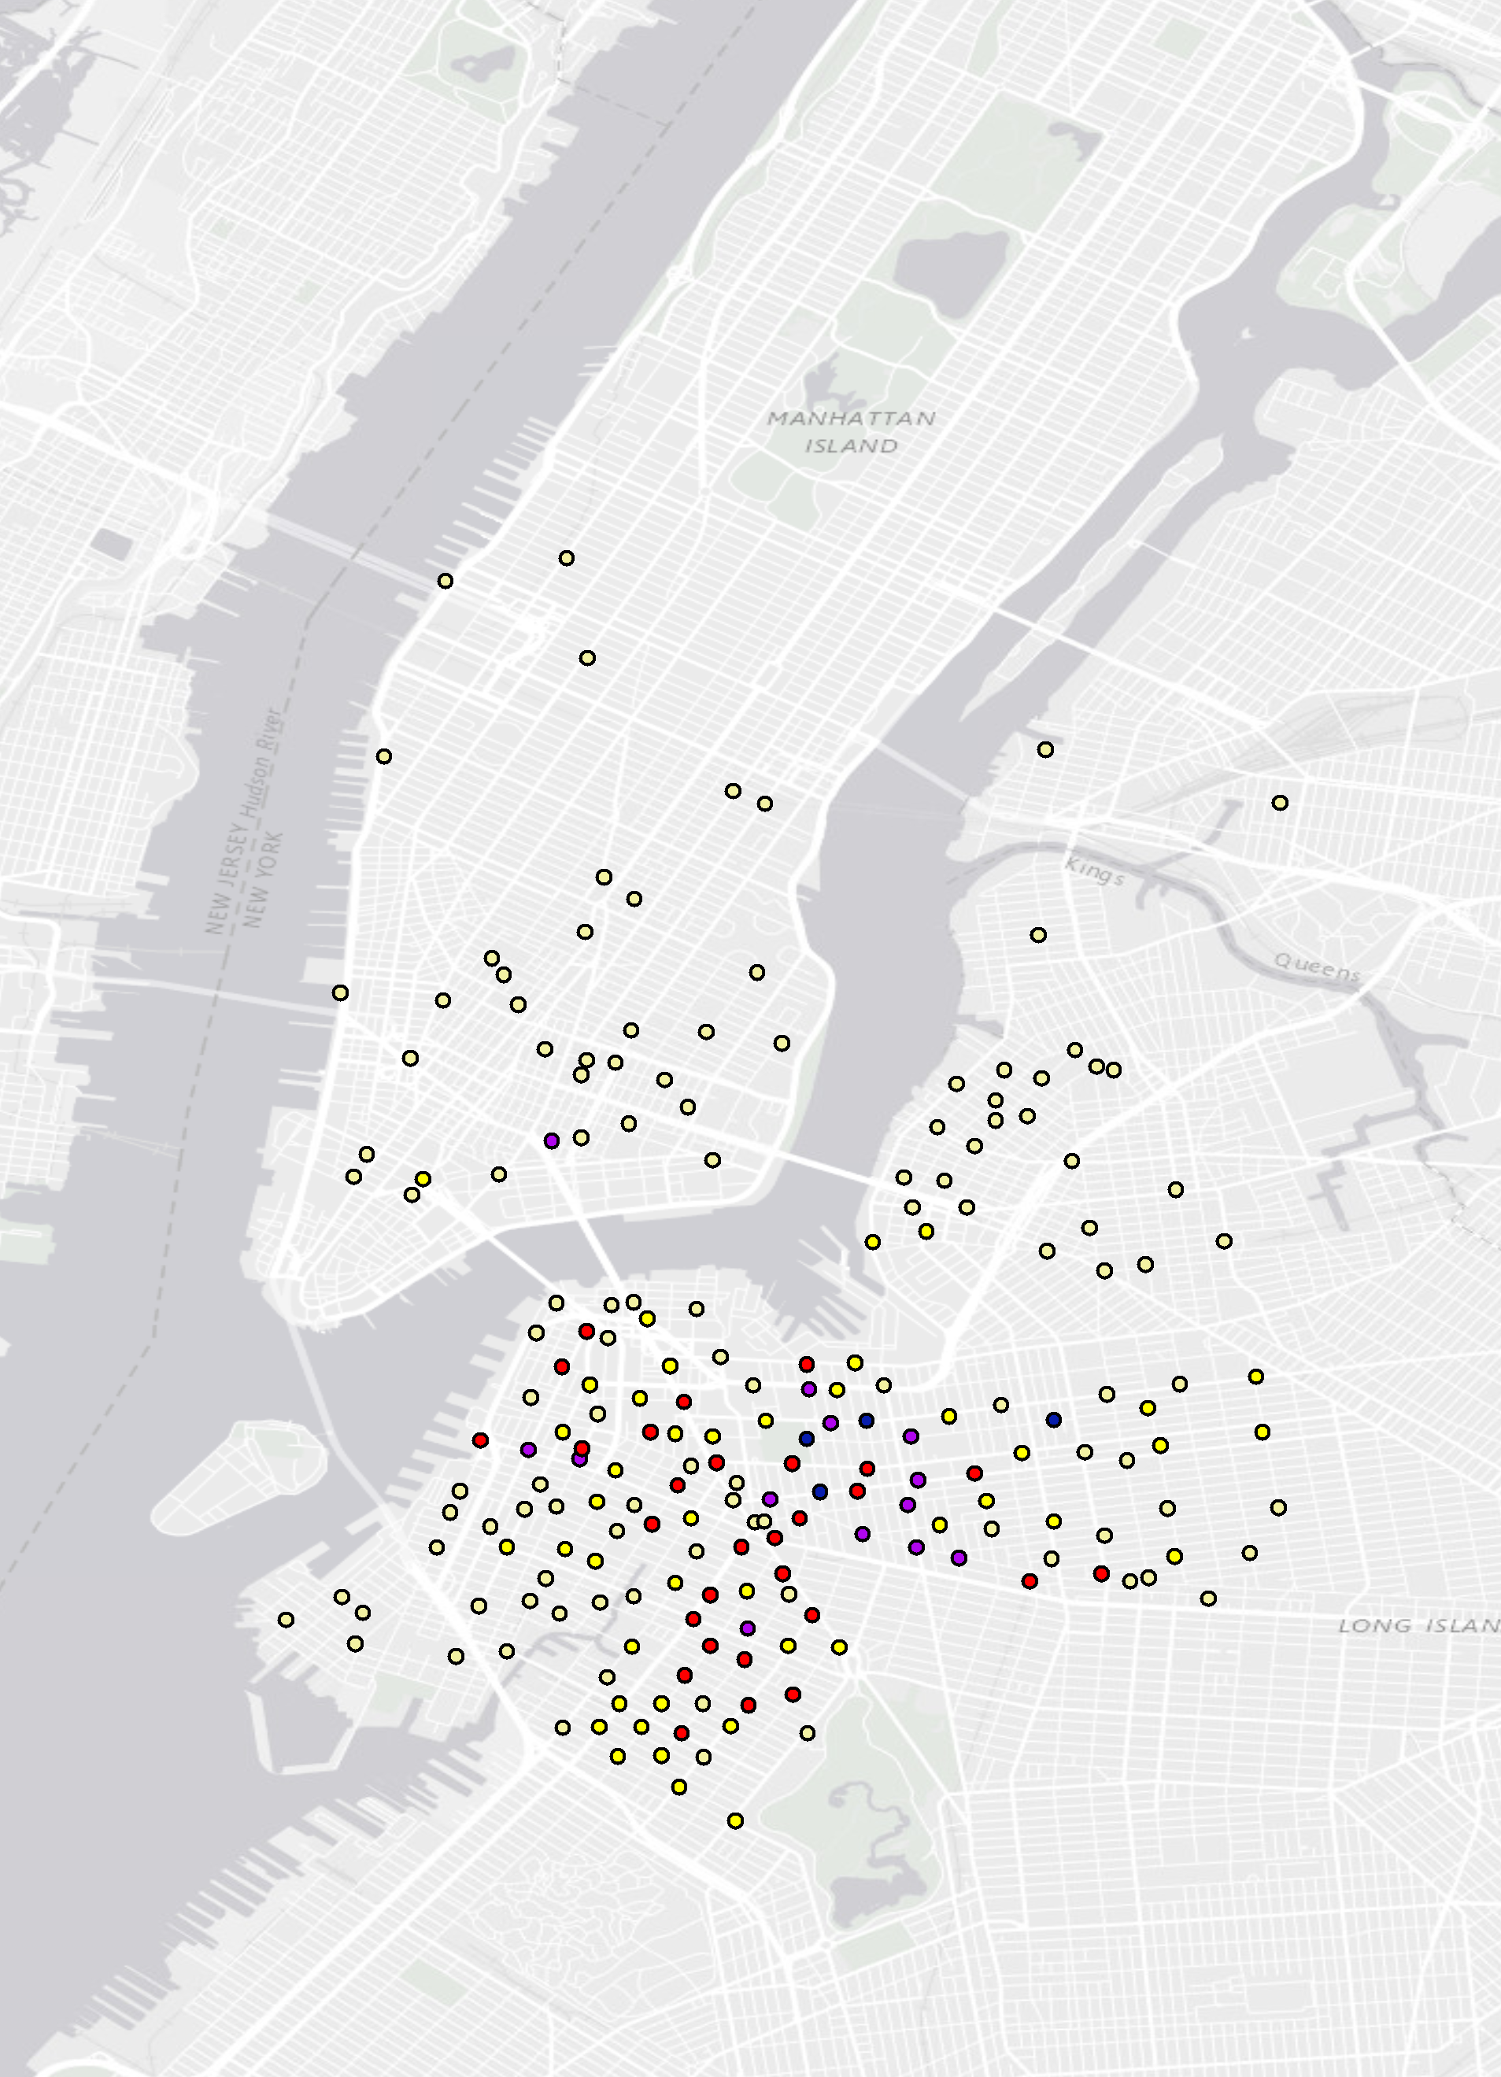
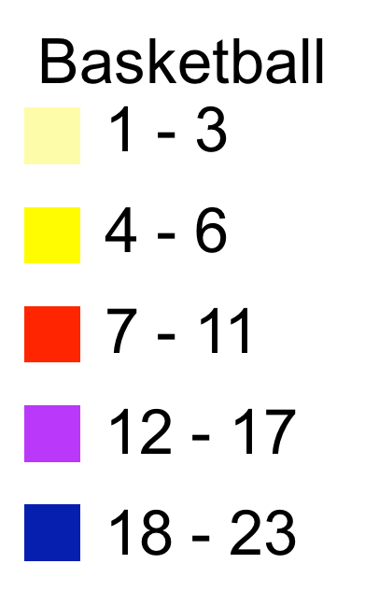
Basketball
1 - 3
4 - 6
7 - 11
12 - 17
18 - 23

Slide 4
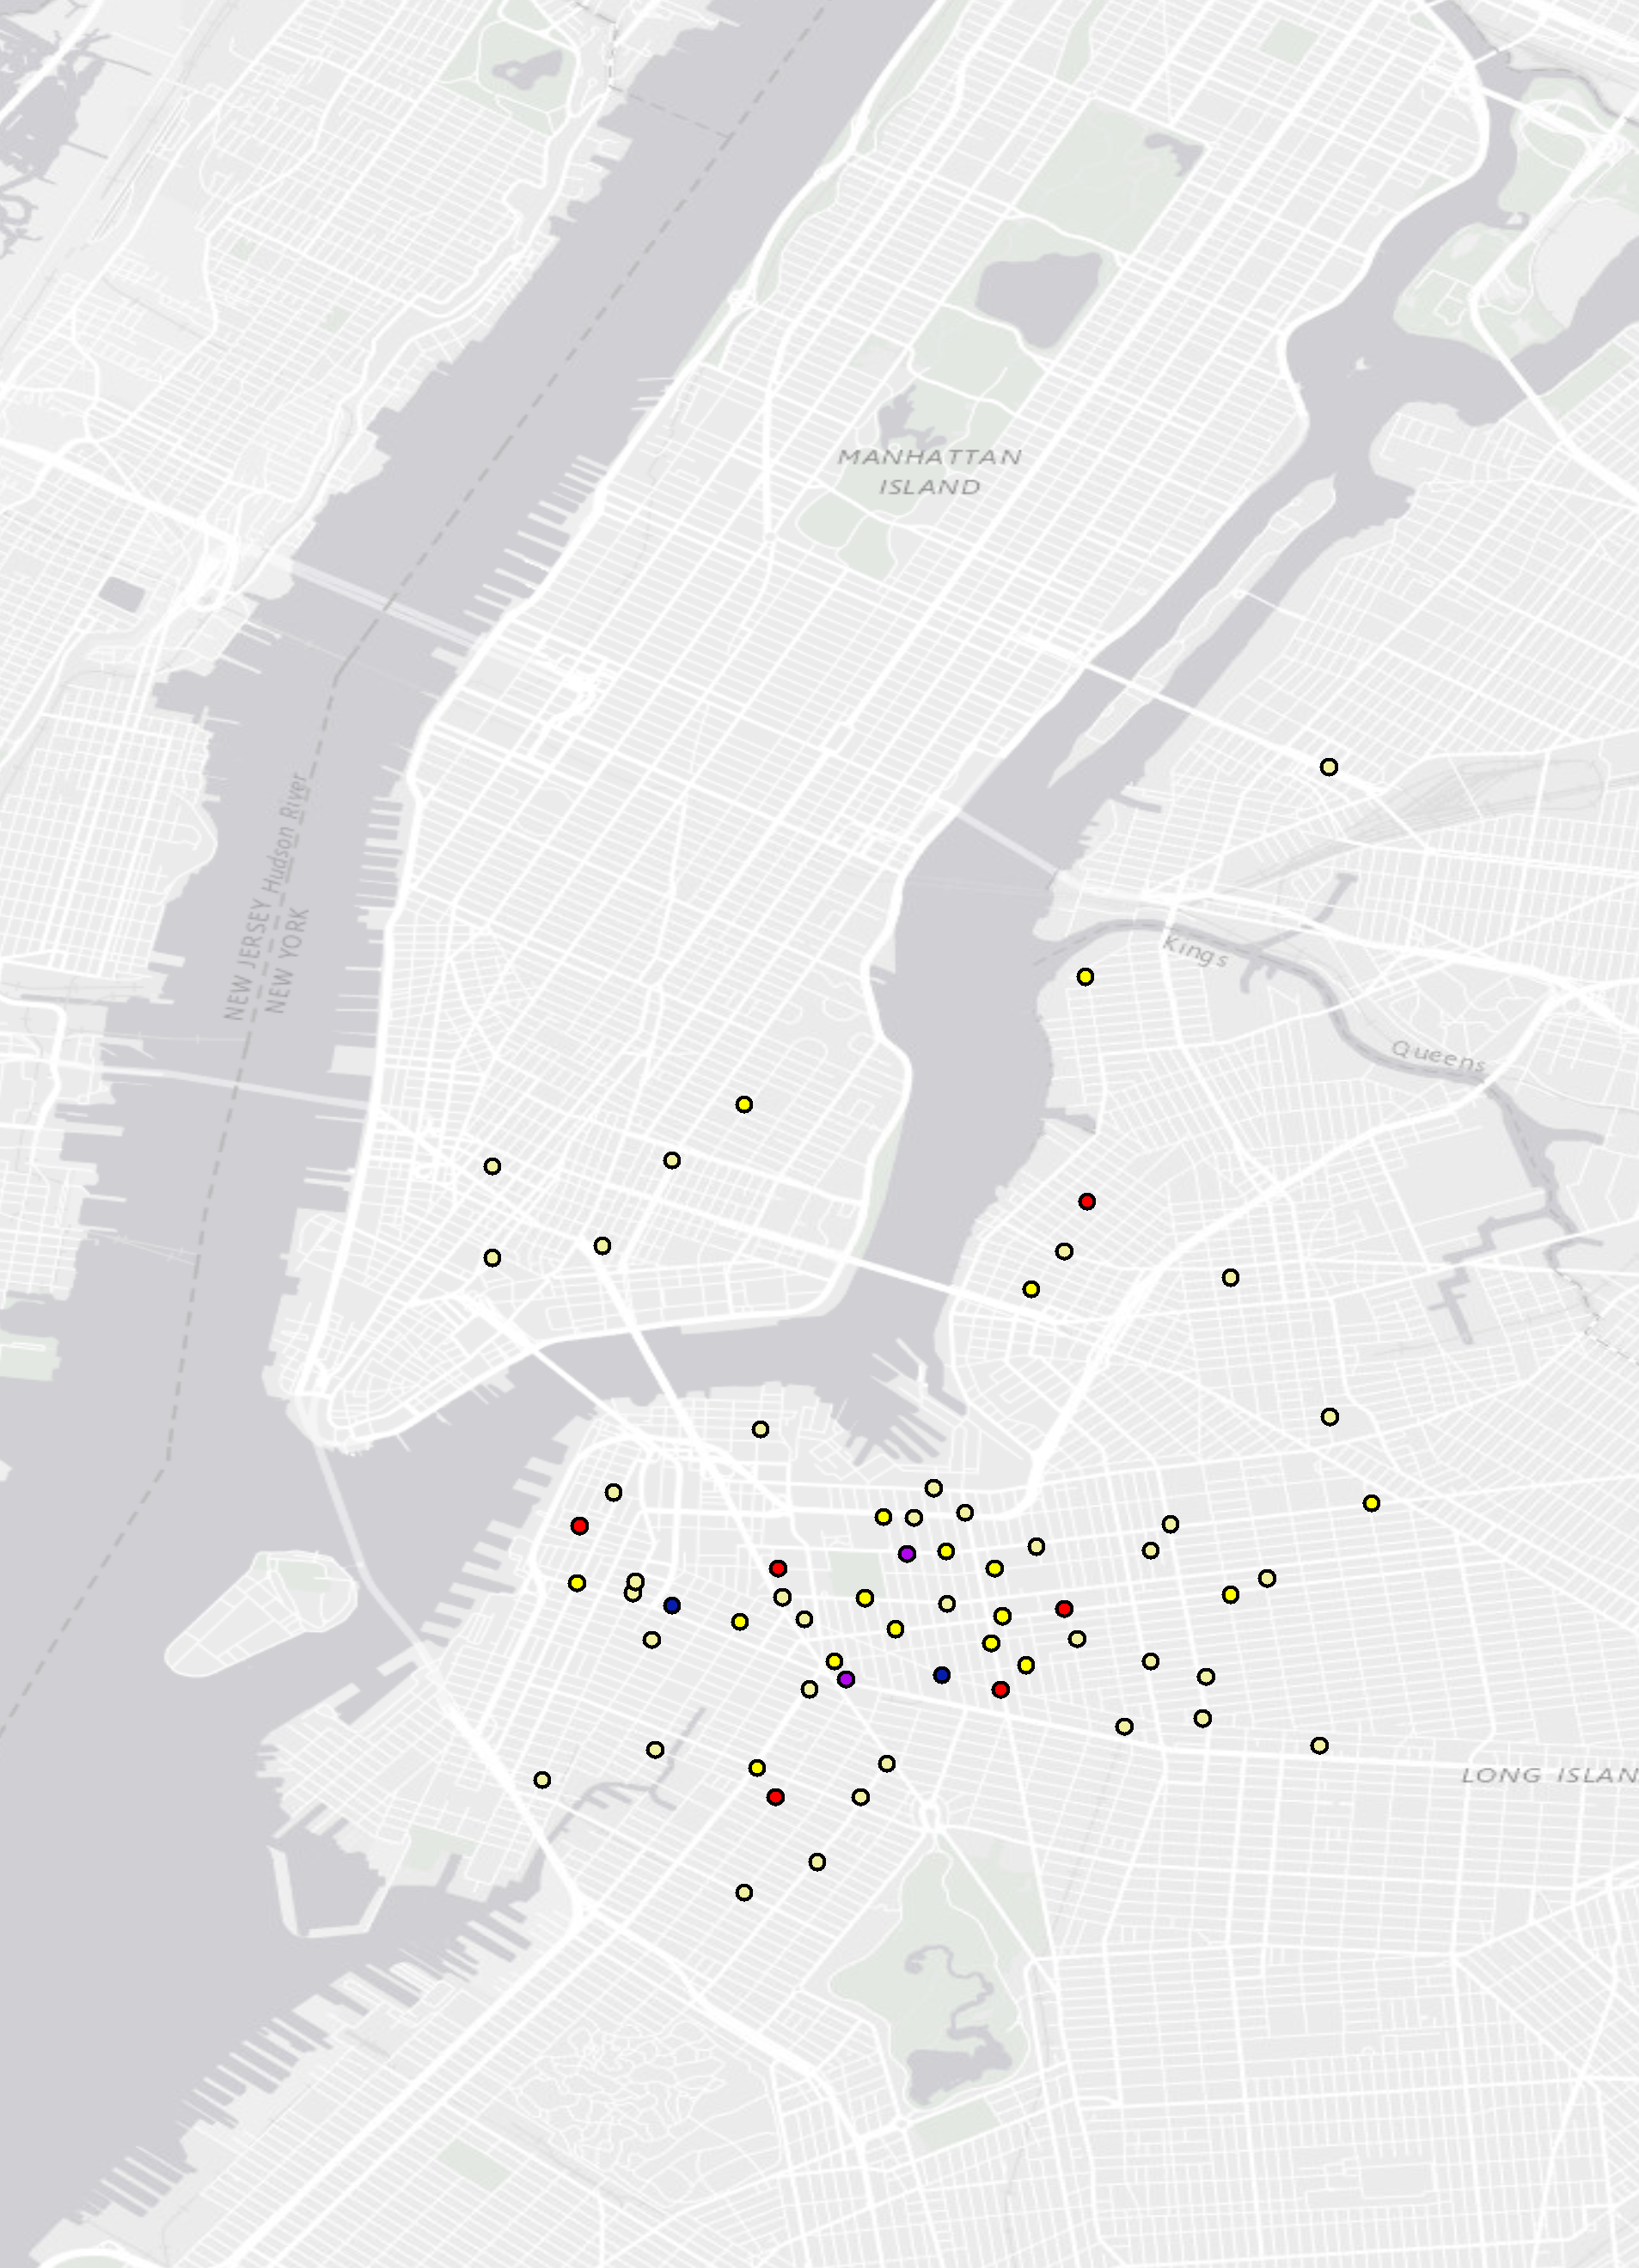
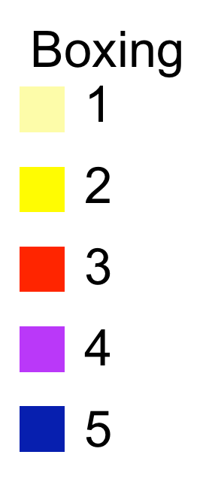
Boxing
1
2
3
4
5

Slide 5
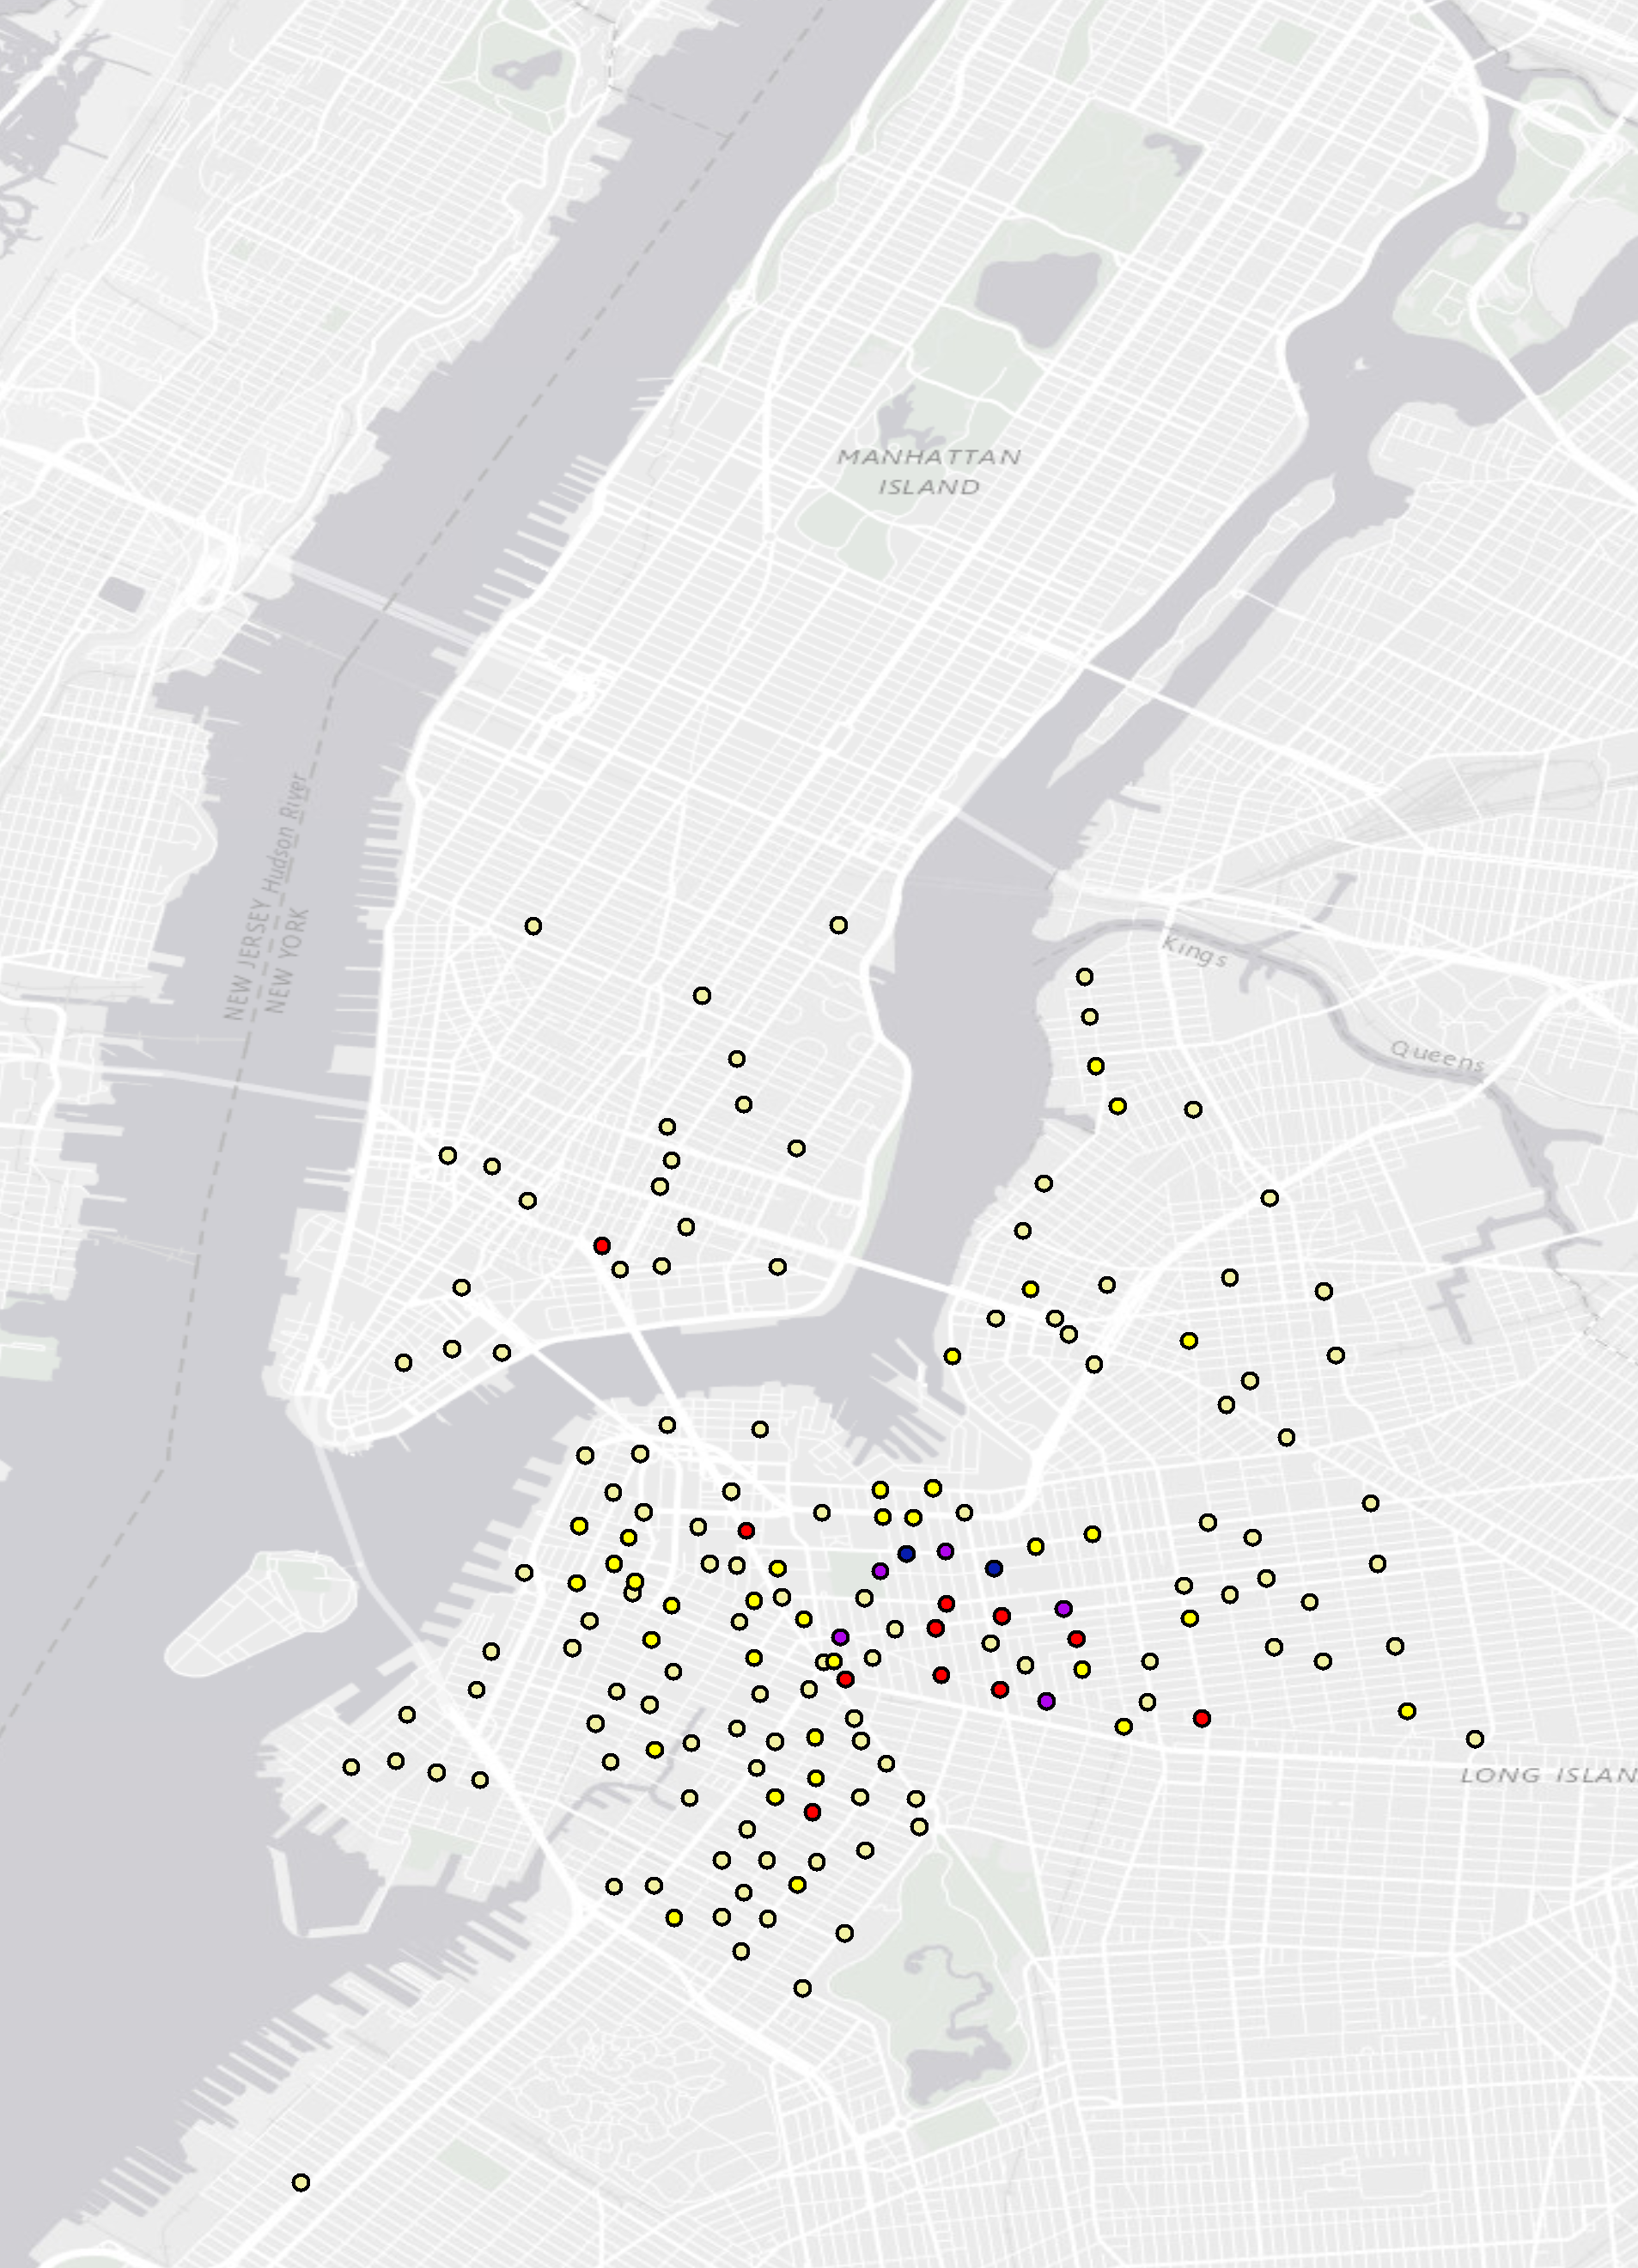
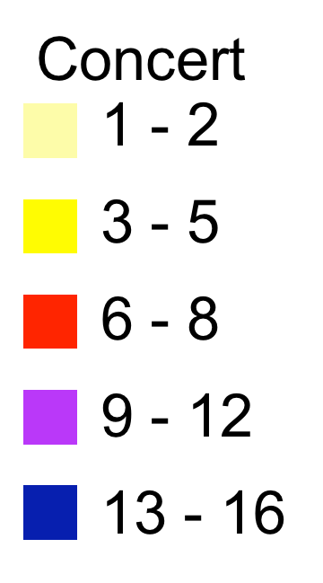
Concert
1 - 2
3 - 5
6 - 8
9 - 12
13 - 16

Slide 6
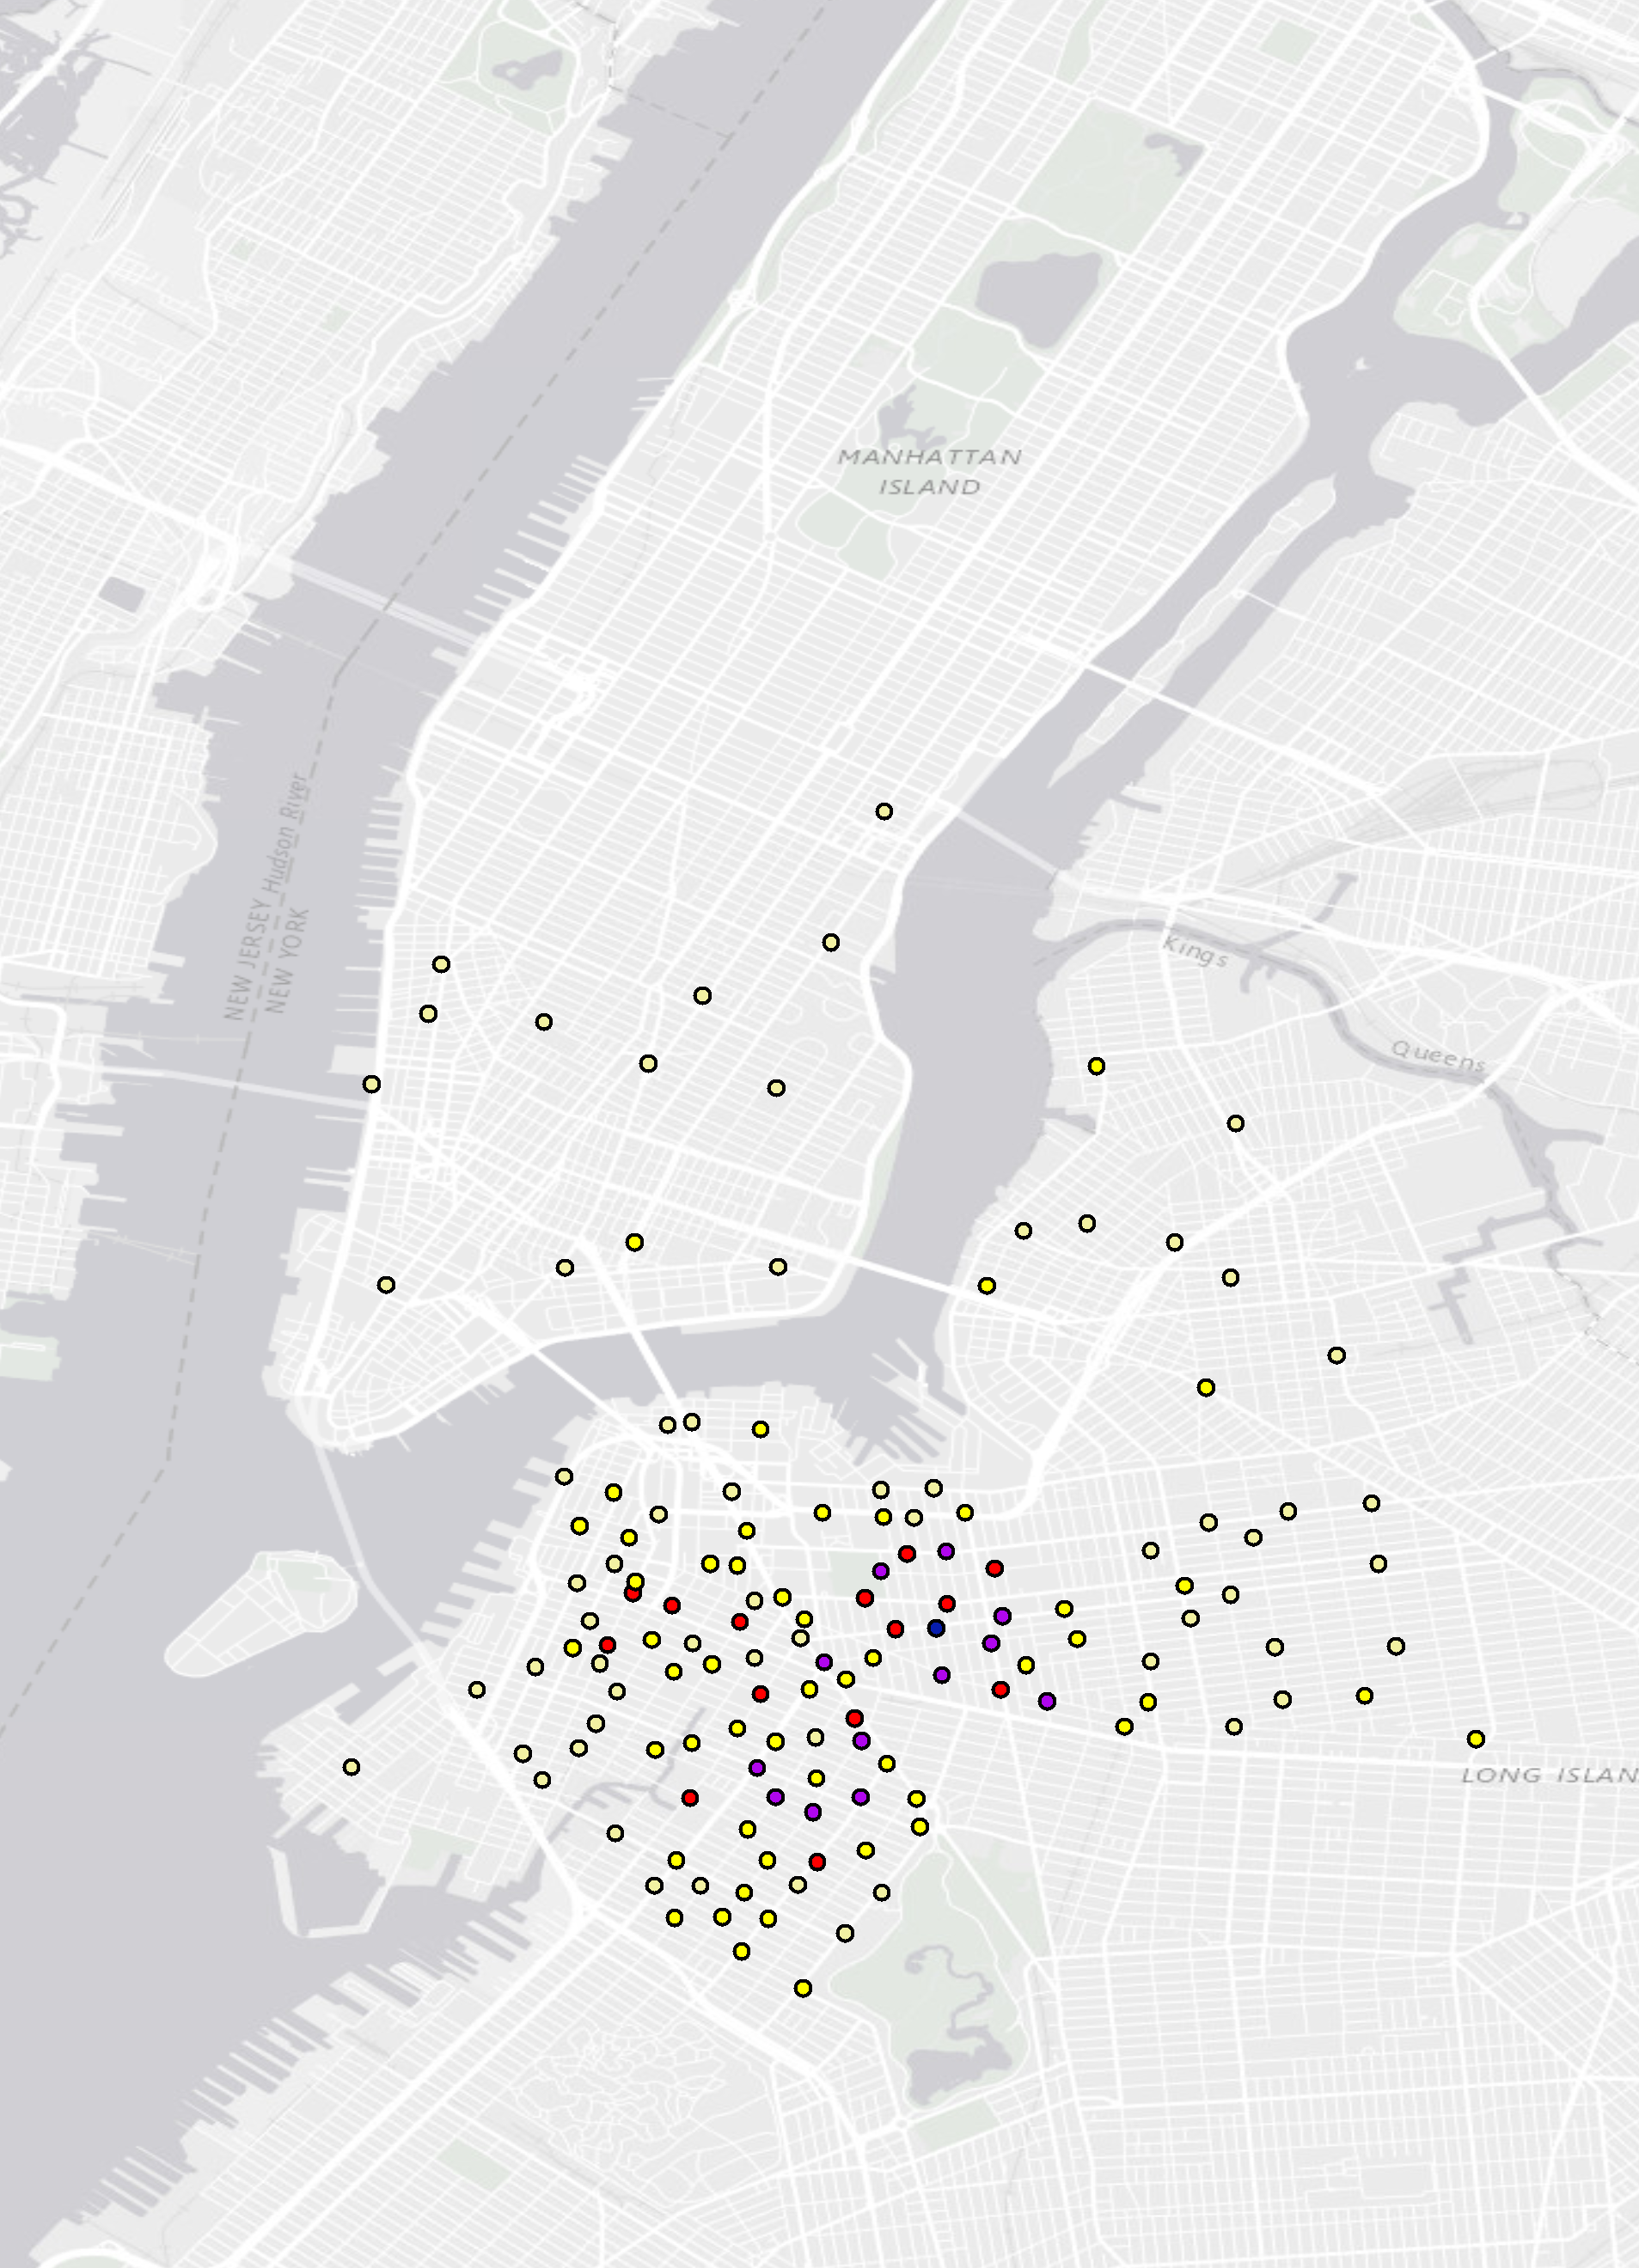
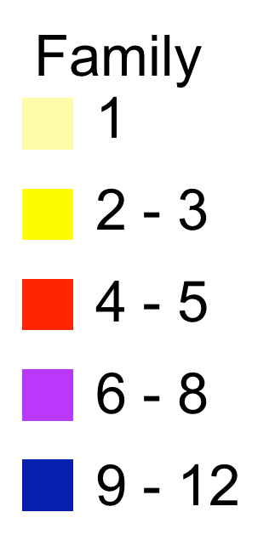
Family
1
2 - 3
4 - 5
6 - 8
9 - 12

Slide 7

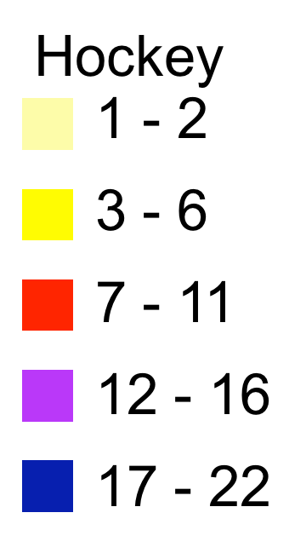
Hockey
1 - 2
3 - 6
7 - 11
12 - 16
17 - 22

